Slide 1
File and I/O System

Slide 2
The Content is prepared with the help of existing text books mentioned below:
References:
Silberschatz, Abraham, Peter B. Galvin, and Greg Gagne. Operating system concepts. Wiley Publishing, 2013.
Stallings, William. Operating Systems 5th Edition. Pearson Education India, 2006.
Tannenbaum, Andrew S. "Modern Operating Systems, 2009."

Slide 3
File Concept
Contiguous logical address space
Types:
Data
numeric
character
binary
Program
Contents defined by file’s creator
Many types
Consider text file, source file, executable file

Slide 4
File Attributes
Name – only information kept in human-readable form
Identifier – unique tag (number) identifies file within file system
Type – needed for systems that support different types
Location – pointer to file location on device
Size – current file size
Protection – controls who can do reading, writing, executing
Time, date, and user identification – data for protection, security, and usage monitoring
Information about files are kept in the directory structure, which is maintained on the disk
Many variations, including extended file attributes such as file checksum
Information kept in the directory structure

Slide 5
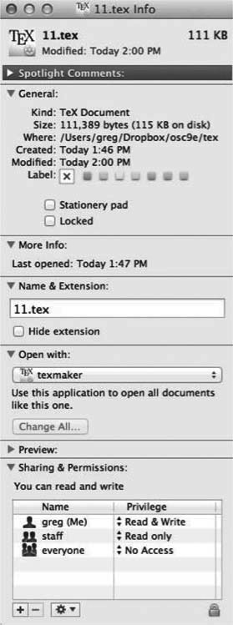
File info Window on Mac OS X

Slide 6
File Operations
File is an abstract data type
Create
Write – at write pointer location
Read – at read pointer location
Reposition within file - seek
Delete
Truncate
Open(F_{i}) – search the directory structure on disk for entry F_{i}, and move the content of entry to memory
Close (F_{i}) – move the content of entry F_{i} in memory to directory structure on disk

Slide 7
Open Files
Several pieces of data are needed to manage open files:
Open-file table: tracks open files
File pointer: pointer to last read/write location, per process that has the file open
File-open count: counter of number of times a file is open – to allow removal of data from open-file table when last processes closes it
Disk location of the file: cache of data access information
Access rights: per-process access mode information

Slide 8
Open File Locking
Provided by some operating systems and file systems
Similar to reader-writer locks
Shared lock similar to reader lock – several processes can acquire concurrently
Exclusive lock similar to writer lock
Mediates access to a file
Mandatory or advisory:
Mandatory – access is denied depending on locks held and requested
Advisory – processes can find status of locks and decide what to do

Slide 9
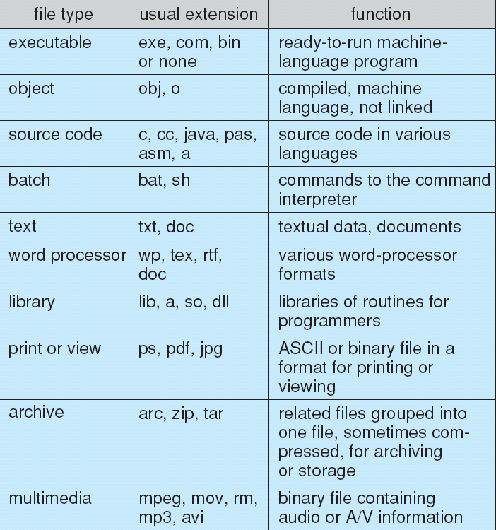
File Types – Name, Extension

Slide 10
File Structure
None - sequence of words, bytes
Simple record structure
Lines
Fixed length
Variable length
Complex Structures
Formatted document
Relocatable load file
Can simulate last two with first method by inserting appropriate control characters
Who decides:
Operating system
Program

Slide 11
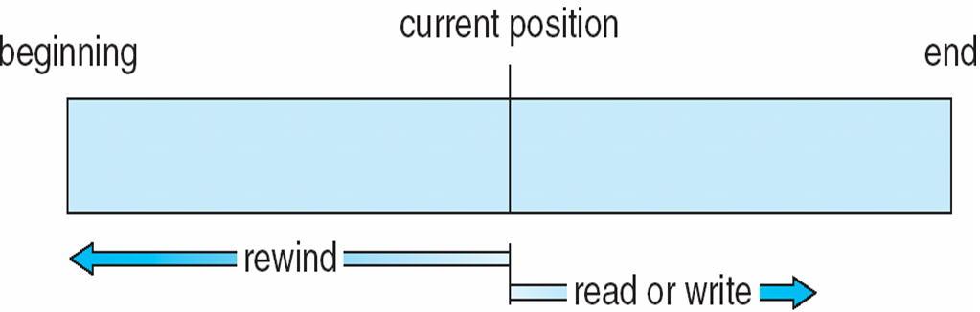
Sequential-access File

Slide 12
Access Methods
Sequential Access
read next
write next
reset
no read after last write
(rewrite)
Direct Access – file is fixed length logical records
read n
write n
position to n
read next
write next
rewrite n
n = relative block number
Relative block numbers allow OS to decide where file should be placed
See allocation problem in Ch 12

Slide 13
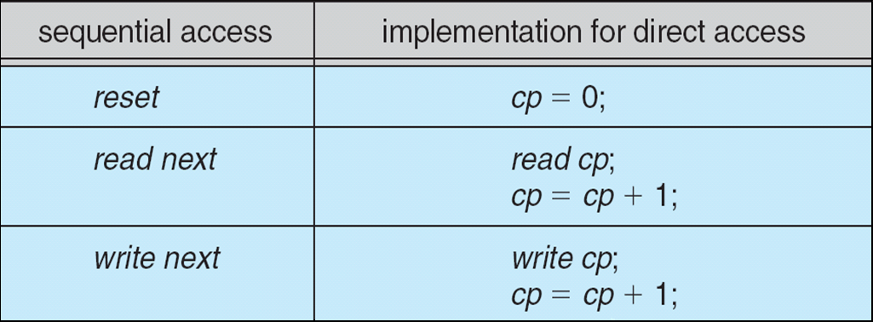
Simulation of Sequential Access on Direct-access File

Slide 14
Other Access Methods
Can be built on top of base methods
General involve creation of an index for the file
Keep index in memory for fast determination of location of data to be operated on (consider UPC code plus record of data about that item)
If too large, index (in memory) of the index (on disk)
IBM indexed sequential-access method (ISAM)
Small master index, points to disk blocks of secondary index
File kept sorted on a defined key
All done by the OS
VMS operating system provides index and relative files as another example (see next slide)

Slide 15
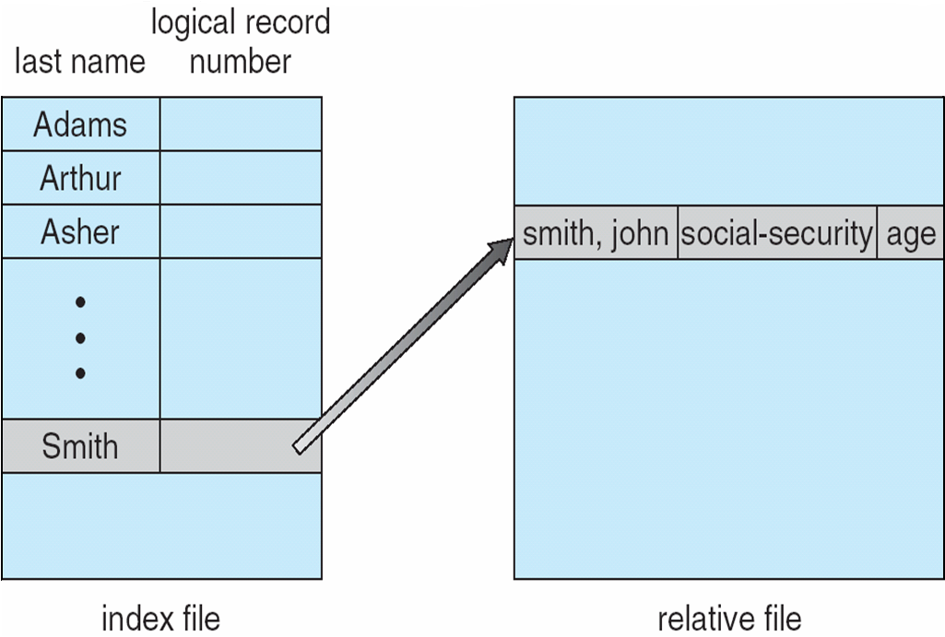
Example of Index and Relative Files

Slide 16
Directory Structure
A collection of nodes containing information about all files
Directory
Files
F 1
F 2
F 3
F 4
F n
Both the directory structure and the files reside on disk

Slide 17
Disk Structure
Disk can be subdivided into partitions
Disks or partitions can be RAID protected against failure
Disk or partition can be used raw – without a file system, or formatted with a file system
Partitions also known as minidisks, slices
Entity containing file system known as a volume
Each volume containing file system also tracks that file system’s info in device directory or volume table of contents
As well as general-purpose file systems there are many special-purpose file systems, frequently all within the same operating system or computer

Slide 18
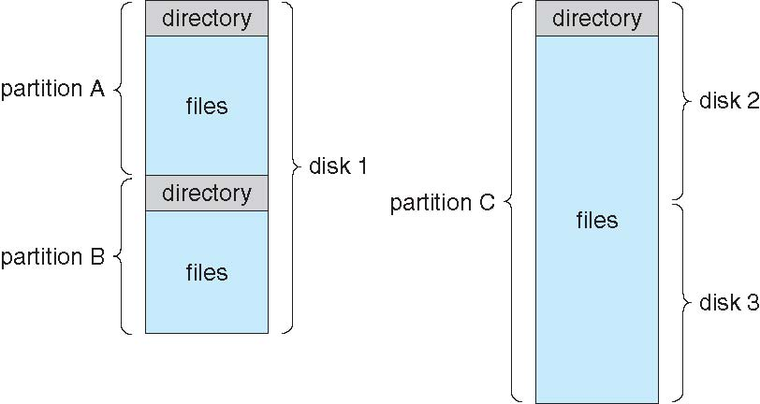
A Typical File-system Organization

Slide 19
Types of File Systems
We mostly talk of general-purpose file systems
But systems frequently have may file systems, some general- and some special- purpose
Consider Solaris has
tmpfs – memory-based volatile FS for fast, temporary I/O
objfs – interface into kernel memory to get kernel symbols for debugging
ctfs – contract file system for managing daemons
lofs – loopback file system allows one FS to be accessed in place of another
procfs – kernel interface to process structures
ufs, zfs – general purpose file systems

Slide 20
Operations Performed on Directory
Search for a file
Create a file
Delete a file
List a directory
Rename a file
Traverse the file system

Slide 21
Directory Organization
The directory is organized logically to obtain
Efficiency – locating a file quickly
Naming – convenient to users
Two users can have same name for different files
The same file can have several different names
Grouping – logical grouping of files by properties, (e.g., all Java programs, all games, …)

Slide 22
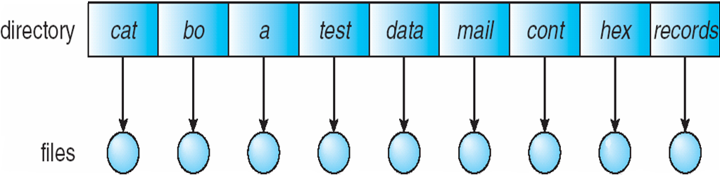
Single-Level Directory
A single directory for all users
Naming problem
Grouping problem

Slide 23
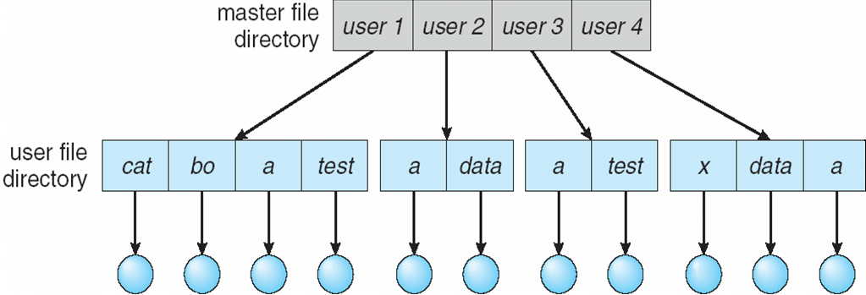
Two-Level Directory
Separate directory for each user
Path name
Can have the same file name for different user
Efficient searching
No grouping capability

Slide 24
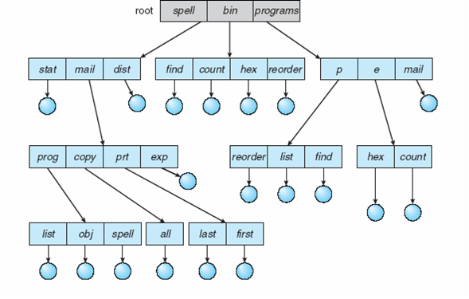
Tree-Structured Directories

Slide 25
Tree-Structured Directories (Cont.)
Efficient searching
Grouping Capability
Current directory (working directory)
cd /spell/mail/prog
type list

Slide 26
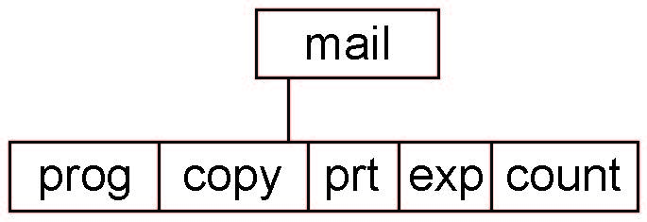
Tree-Structured Directories (Cont.)
Absolute or relative path name
Creating a new file is done in current directory
Delete a file
rm <file-name>
Creating a new subdirectory is done in current directory
mkdir <dir-name>
Example: if in current directory /mail
mkdir count
Deleting “mail” ⇒ deleting the entire subtree rooted by “mail”

Slide 27
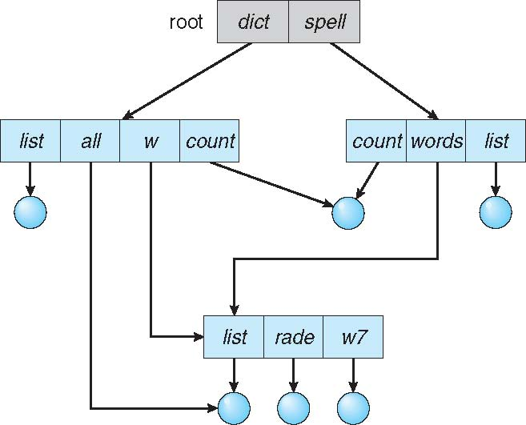
Acyclic-Graph Directories
Have shared subdirectories and files

Slide 28
Acyclic-Graph Directories (Cont.)
Two different names (aliasing)
If dict deletes list ⇒ dangling pointer
Solutions:
Backpointers, so we can delete all pointers Variable size records a problem
Backpointers using a daisy chain organization
Entry-hold-count solution
New directory entry type
Link – another name (pointer) to an existing file
Resolve the link – follow pointer to locate the file

Slide 29
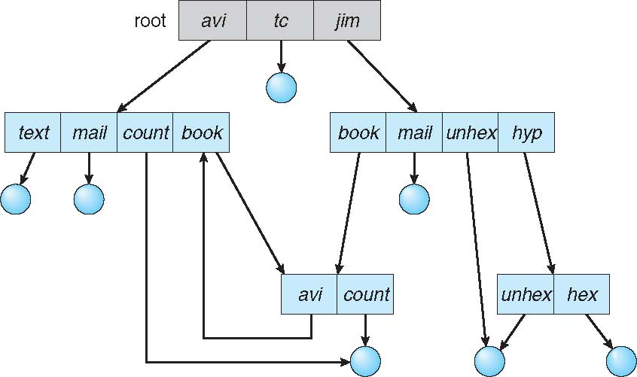
General Graph Directory

Slide 30
General Graph Directory (Cont.)
How do we guarantee no cycles?
Allow only links to file not subdirectories
Garbage collection
Every time a new link is added use a cycle detection algorithm to determine whether it is OK

Slide 31
Protection
File owner/creator should be able to control:
what can be done
by whom
Types of access
Read
Write
Execute
Append
Delete
List

Slide 32
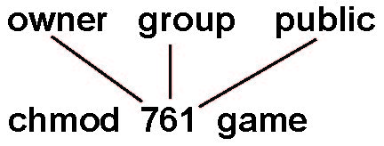
Access Lists and Groups
Mode of access: read, write, execute
Three classes of users on Unix / Linux
RWX
a) owner access 7 ⇒ 1 1 1 RWX
b) group access 6 ⇒ 1 1 0
RWX
c) public access 1 ⇒ 0 0 1
Ask manager to create a group (unique name), say G, and add some users to the group.
For a particular file (say game) or subdirectory, define an appropriate access.
Attach a group to a file chgrp G game

Slide 33
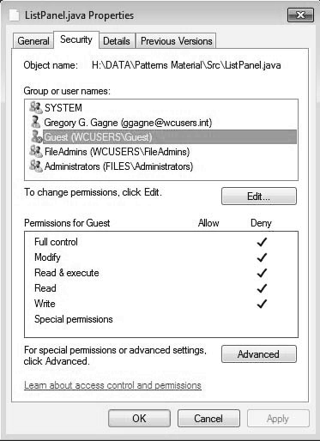
Windows 7 Access-Control List Management

Slide 34
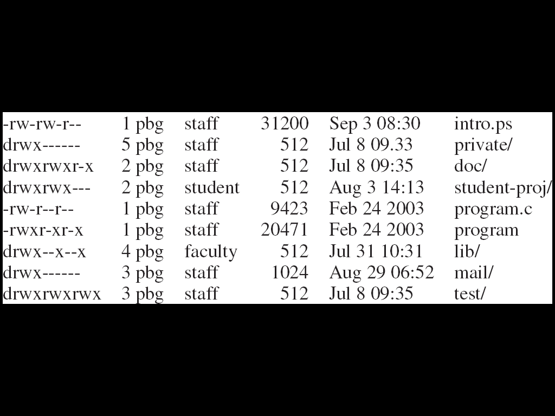
A Sample UNIX Directory Listing

Slide 35
File-System Structure
File structure
Logical storage unit
Collection of related information
File system resides on secondary storage (disks)
Provided user interface to storage, mapping logical to physical
Provides efficient and convenient access to disk by allowing data to be stored, located retrieved easily
Disk provides in-place rewrite and random access
I/O transfers performed in blocks of sectors (usually 512 bytes)
File control block – storage structure consisting of information about a file
Device driver controls the physical device
File system organized into layers

Slide 36
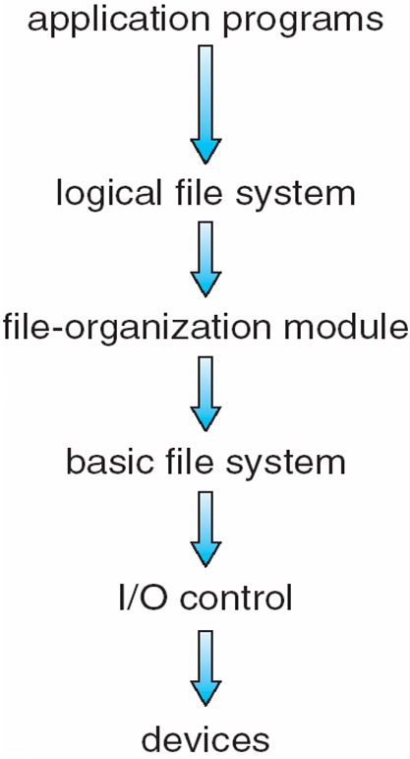
Layered File System

Slide 37
File System Layers
Device drivers manage I/O devices at the I/O control layer
Given commands like “read drive1, cylinder 72, track 2, sector 10, into memory location 1060” outputs low-level hardware specific commands to hardware controller
Basic file system given command like “retrieve block 123” translates to device driver
Also manages memory buffers and caches (allocation, freeing, replacement)
Buffers hold data in transit
Caches hold frequently used data
File organization module understands files, logical address, and physical blocks
Translates logical block # to physical block #
Manages free space, disk allocation

Slide 38
File System Layers (Cont.)
Logical file system manages metadata information
Translates file name into file number, file handle, location by maintaining file control blocks (inodes in UNIX)
Directory management
Protection
Layering useful for reducing complexity and redundancy, but adds overhead and can decrease performanceTranslates file name into file number, file handle, location by maintaining file control blocks (inodes in UNIX)
Logical layers can be implemented by any coding method according to OS designer

Slide 39
File System Layers (Cont.)
Many file systems, sometimes many within an operating system
Each with its own format (CD-ROM is ISO 9660; Unix has UFS, FFS; Windows has FAT, FAT32, NTFS as well as floppy, CD, DVD Blu-ray, Linux has more than 40 types, with extended file system ext2 and ext3 leading; plus distributed file systems, etc.)
New ones still arriving – ZFS, GoogleFS, Oracle ASM, FUSE

Slide 40
Allocation Methods - Contiguous
An allocation method refers to how disk blocks are allocated for files:
Contiguous allocation – each file occupies set of contiguous blocks
Best performance in most cases
Simple – only starting location (block #) and length (number of blocks) are required
Problems include finding space for file, knowing file size, external fragmentation, need for compaction off-line (downtime) or on-line

Slide 41
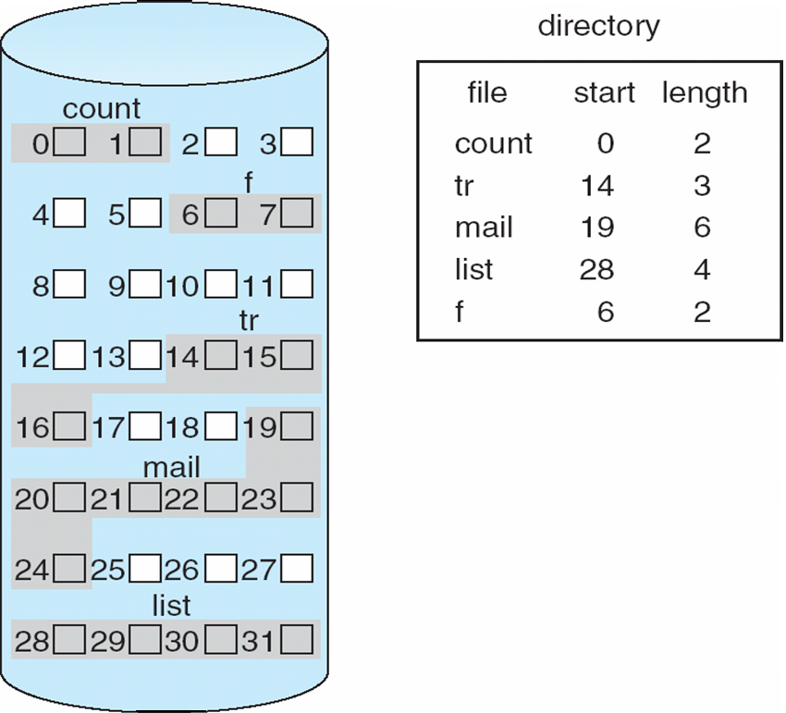
Contiguous Allocation
Mapping from logical to physical
Q
LA/512
R
Block to be accessed = Q + starting address
Displacement into block = R

Slide 42
Extent-Based Systems
Many newer file systems (i.e., Veritas File System) use a modified contiguous allocation scheme
Extent-based file systems allocate disk blocks in extents
An extent is a contiguous block of disks
Extents are allocated for file allocation
A file consists of one or more extents

Slide 43
Allocation Methods - Linked
Linked allocation – each file a linked list of blocks
File ends at nil pointer
No external fragmentation
Each block contains pointer to next block
No compaction, external fragmentation
Free space management system called when new block needed
Improve efficiency by clustering blocks into groups but increases internal fragmentation
Reliability can be a problem
Locating a block can take many I/Os and disk seeks

Slide 44
Allocation Methods – Linked (Cont.)
FAT (File Allocation Table) variation
Beginning of volume has table, indexed by block number
Much like a linked list, but faster on disk and cacheable
New block allocation simple

Slide 45
Linked Allocation
Each file is a linked list of disk blocks: blocks may be scattered anywhere on the disk
block =
pointer
Mapping
Q
LA/511
R
Block to be accessed is the Qth block in the linked chain of blocks representing the file.
Displacement into block = R + 1

Slide 46
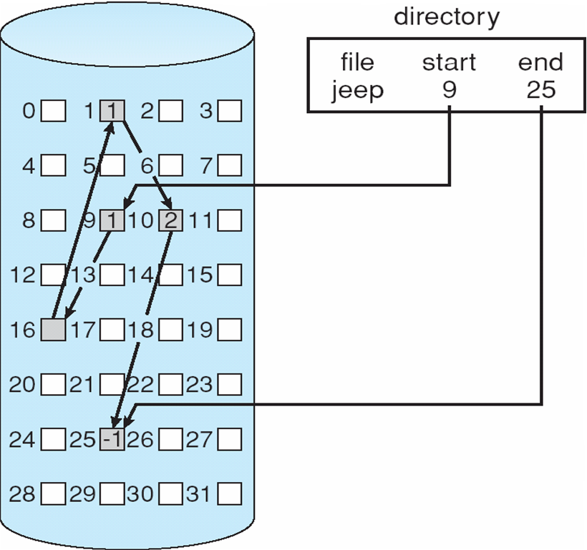
Linked Allocation

Slide 47
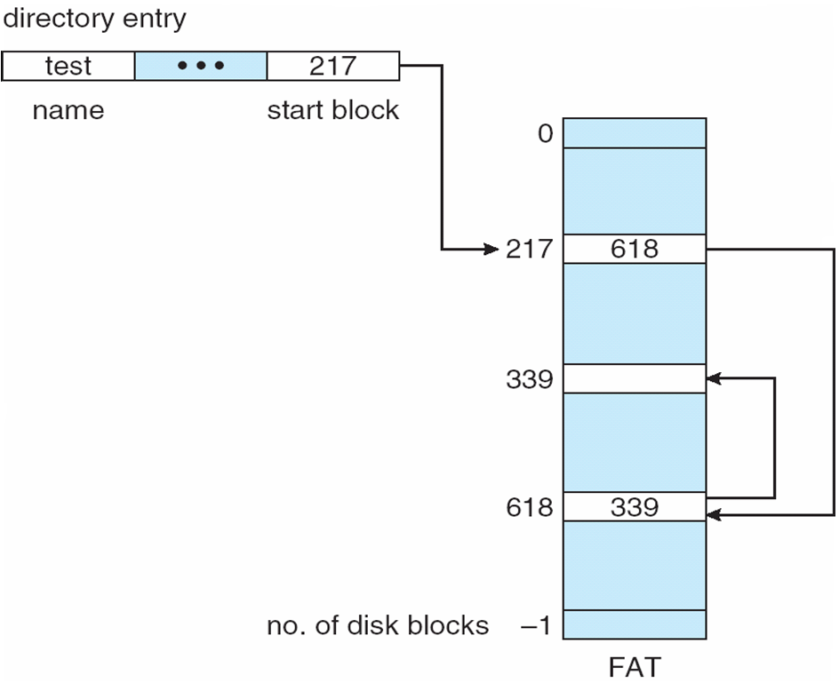
File-Allocation Table

Slide 48
Allocation Methods - Indexed
Indexed allocation
Each file has its own index block(s) of pointers to its data blocks
Logical view

Slide 49
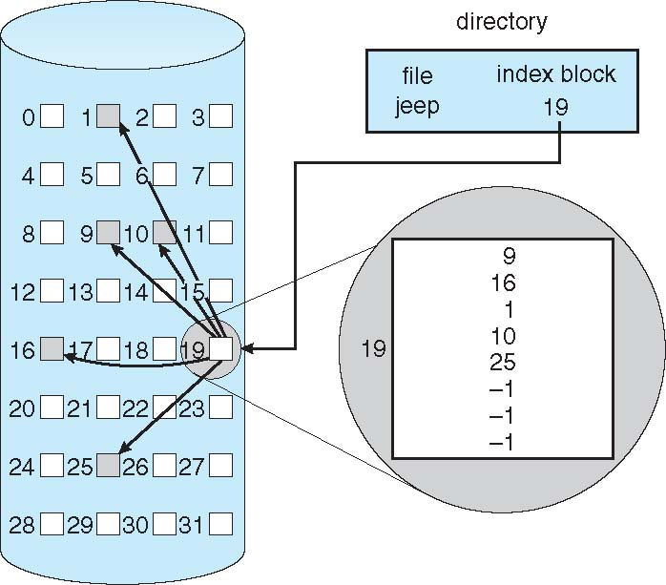
Example of Indexed Allocation

Slide 50
Indexed Allocation (Cont.)
Need index table
Random access
Dynamic access without external fragmentation, but have overhead of index block
Mapping from logical to physical in a file of maximum size of 256K bytes and block size of 512 bytes. We need only 1 block for index table
Q
LA/512
R
Q = displacement into index table
R = displacement into block

Slide 51
Indexed Allocation – Mapping (Cont.)
Mapping from logical to physical in a file of unbounded length (block size of 512 words)
Linked scheme – Link blocks of index table (no limit on size)
Q₁
LA / (512 x 511)
R₁
Q₁ = block of index table
R₁ is used as follows:
Q₂
R₁ / 512
R₂
Q₂ = displacement into block of index table
R₂ displacement into block of file:

Slide 52
Indexed Allocation – Mapping (Cont.)
Two-level index (4K blocks could store 1,024 four-byte pointers in outer index -> 1,048,567 data blocks and file size of up to 4GB)
Q₁
LA / (512 x 512)
R₁
Q₁ = displacement into outer-index
R₁ is used as follows:
Q₂
R₁ / 512
R₂
Q₂ = displacement into block of index table
R₂ displacement into block of file:

Slide 53
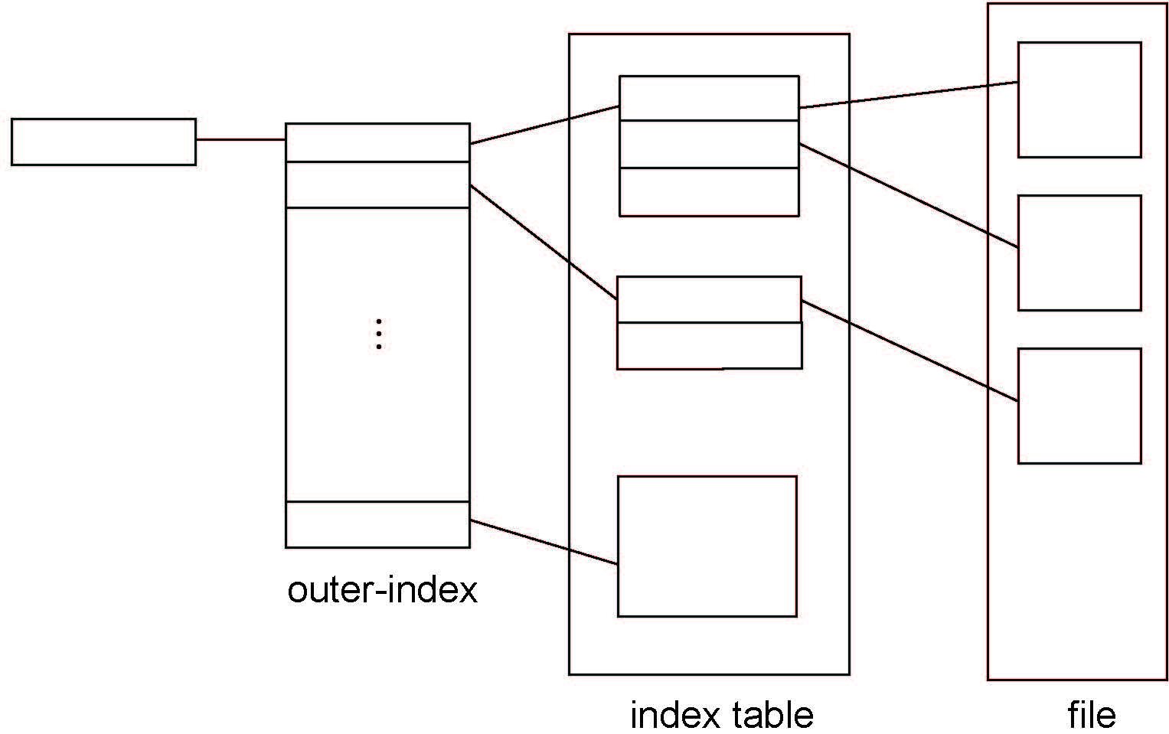
Indexed Allocation – Mapping (Cont.)

Slide 54
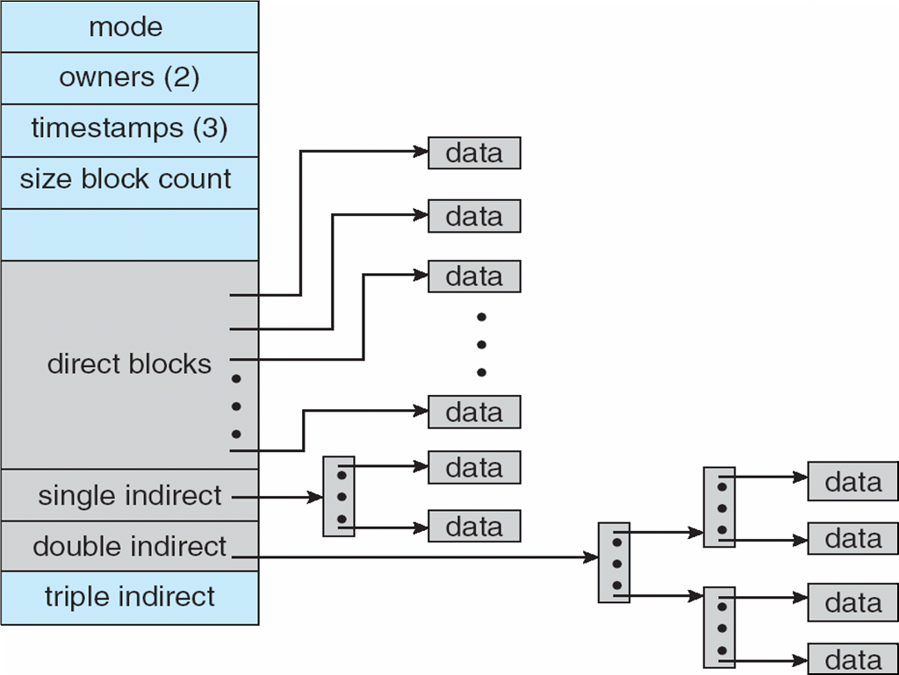
Combined Scheme: UNIX UFS
4K bytes per block, 32-bit addresses
More index blocks than can be addressed with 32-bit file pointer

Slide 55
Performance
Best method depends on file access type
Contiguous great for sequential and random
Linked good for sequential, not random
Declare access type at creation -> select either contiguous or linked
Indexed more complex
Single block access could require 2 index block reads then data block read
Clustering can help improve throughput, reduce CPU overhead

Slide 56
Performance (Cont.)
Adding instructions to the execution path to save one disk I/O is reasonable
Intel Core i7 Extreme Edition 990x (2011) at 3.46Ghz = 159,000 MIPS
http://en.wikipedia.org/wiki/Instructions_per_second
Typical disk drive at 250 I/Os per second
159,000 MIPS / 250 = 630 million instructions during one disk I/O
Fast SSD drives provide 60,000 IOPS
159,000 MIPS / 60,000 = 2.65 millions instructions during one disk I/O

Slide 57
Free-Space Management
File system maintains free-space list to track available blocks/clusters
(Using term “block” for simplicity)
Bit vector or bit map (n blocks)
0
1
2
n-1
…
1 ⇒ block[i] free
0 ⇒ block[i] occupied
bit[i] =

Block number calculation
(number of bits per word) *
(number of 0-value words) +
offset of first 1 bit
CPUs have instructions to return offset within word of first “1” bit

Slide 58
Free-Space Management (Cont.)
Bit map requires extra space
Example:
block size = 4KB = 2¹² bytes
disk size = 2⁴⁰ bytes (1 terabyte)
n = 2⁴⁰/2¹² = 2²⁸ bits (or 32MB)
if clusters of 4 blocks -> 8MB of memory
Easy to get contiguous files

Slide 59
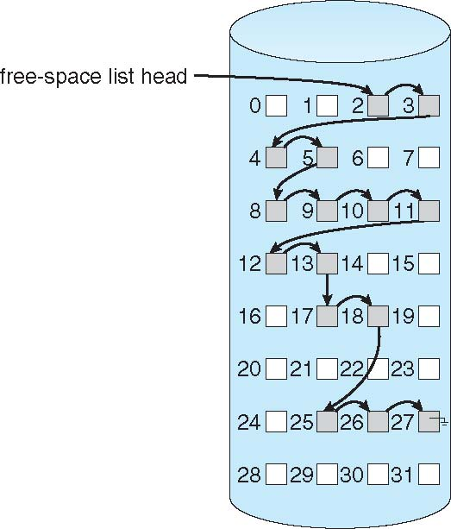
Linked Free Space List on Disk
Linked list (free list)
Cannot get contiguous space easily
No waste of space
No need to traverse the entire list (if # free blocks recorded)

Slide 60
Free-Space Management (Cont.)
Grouping
Modify linked list to store address of next n-1 free blocks in first free block, plus a pointer to next block that contains free-block-pointers (like this one)
Counting
Because space is frequently contiguously used and freed, with contiguous-allocation allocation, extents, or clustering
Keep address of first free block and count of following free blocks
Free space list then has entries containing addresses and counts

Slide 61
Free-Space Management (Cont.)
Space Maps
Used in ZFS
Consider meta-data I/O on very large file systems
Full data structures like bit maps couldn’t fit in memory -> thousands of I/Os
Divides device space into metaslab units and manages metaslabs
Given volume can contain hundreds of metaslabs
Each metaslab has associated space map
Uses counting algorithm
But records to log file rather than file system
Log of all block activity, in time order, in counting format
Metaslab activity -> load space map into memory in balanced-tree structure, indexed by offset
Replay log into that structure
Combine contiguous free blocks into single entry

Slide 62
I/O System

Slide 63
Overview
I/O management is a major component of operating system design and operation
Important aspect of computer operation
I/O devices vary greatly
Various methods to control them
Performance management
New types of devices frequent
Ports, busses, device controllers connect to various devices
Device drivers encapsulate device details
Present uniform device-access interface to I/O subsystem

Slide 64
I/O Hardware
Incredible variety of I/O devices
Storage
Transmission
Human-interface
Common concepts – signals from I/O devices interface with computer
Port – connection point for device
Bus - daisy chain or shared direct access
PCI bus common in PCs and servers, PCI Express (PCIe)
expansion bus connects relatively slow devices
Serial-attached SCSI (SAS) common disk interface

Slide 65
I/O Hardware (Cont.)
Controller (host adapter) – electronics that operate port, bus, device
Sometimes integrated
Sometimes separate circuit board (host adapter)
Contains processor, microcode, private memory, bus controller, etc.
Some talk to per-device controller with bus controller, microcode, memory, etc.

Slide 66
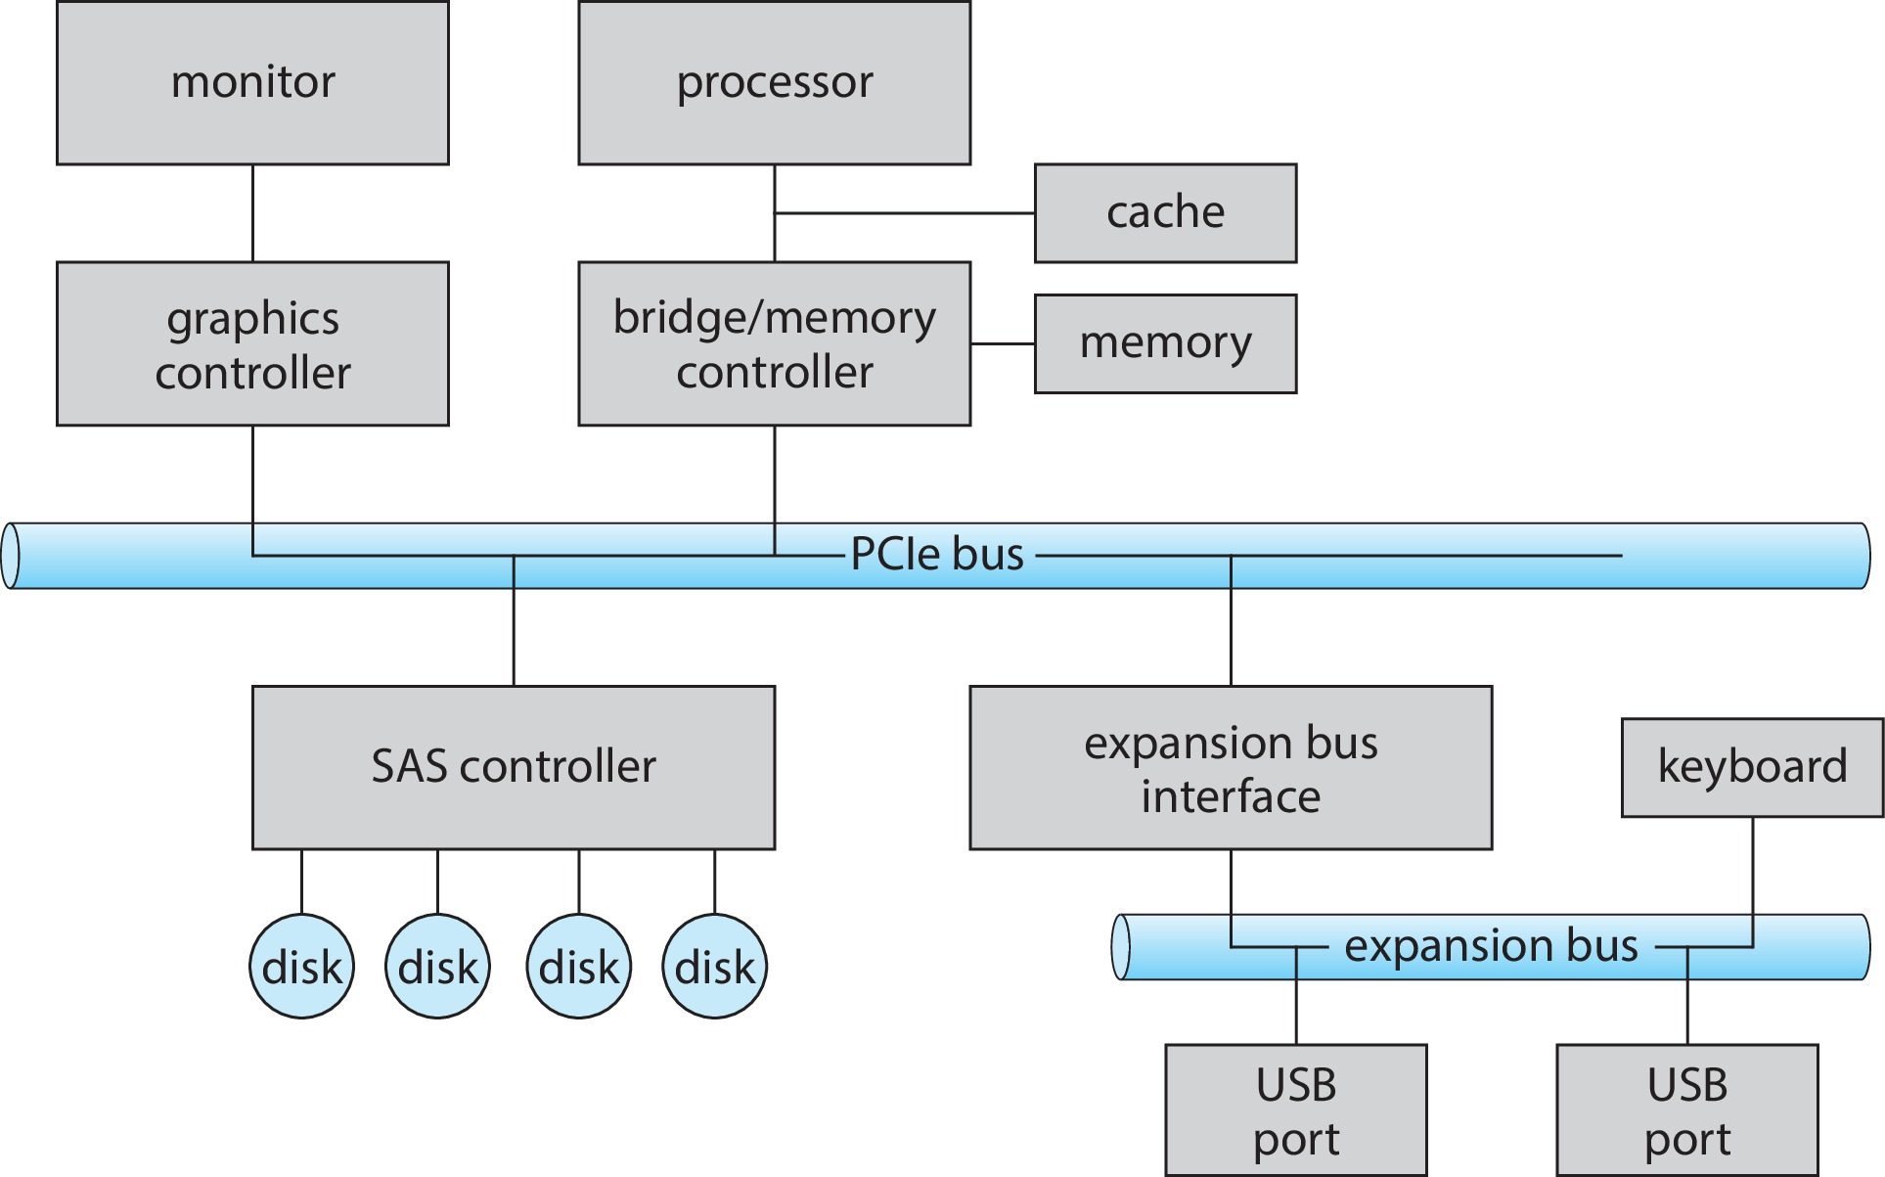
A Typical PC Bus Structure

Slide 67
I/O Hardware (Cont.)
Fibre channel (FC) is complex controller, usually separate circuit board (host-bus adapter, HBA) plugging into bus
I/O instructions control devices
Devices usually have registers where device driver places commands, addresses, and data to write, or read data from registers after command execution
Data-in register, data-out register, status register, control register
Typically 1-4 bytes, or FIFO buffer

Slide 68
I/O Hardware (Cont.)
Devices have addresses, used by
Direct I/O instructions
Memory-mapped I/O
Device data and command registers mapped to processor address space
Especially for large address spaces (graphics)

Slide 69
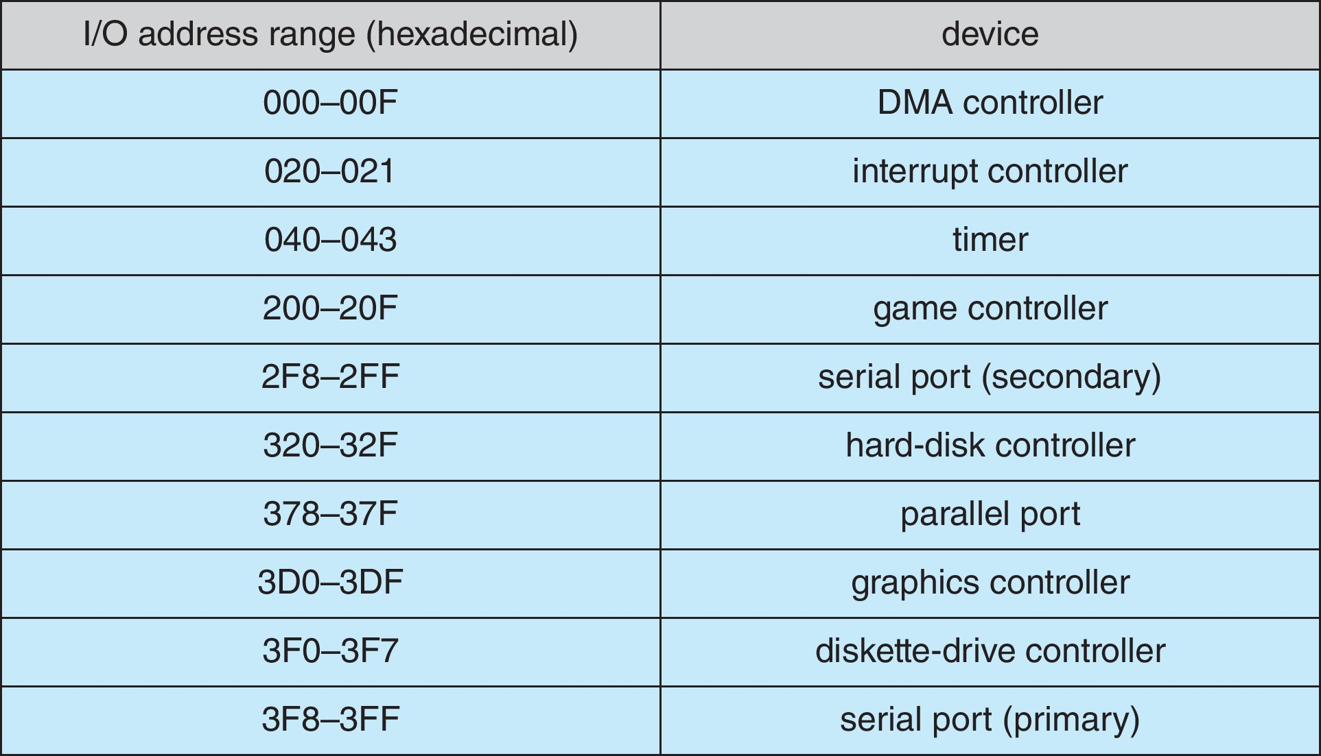
Device I/O Port Locations on PCs (partial)

Slide 70
Polling
For each byte of I/O
Read busy bit from status register until 0
Host sets read or write bit and if write copies data into data-out register
Host sets command-ready bit
Controller sets busy bit, executes transfer
Controller clears busy bit, error bit, command-ready bit when transfer done
Step 1 is busy-wait cycle to wait for I/O from device
Reasonable if device is fast
But inefficient if device slow
CPU switches to other tasks?
But if miss a cycle data overwritten / lost

Slide 71
Interrupts
Polling can happen in 3 instruction cycles
Read status, logical-and to extract status bit, branch if not zero
How to be more efficient if non-zero infrequently?
CPU Interrupt-request line triggered by I/O device
Checked by processor after each instruction
Interrupt handler receives interrupts
Maskable to ignore or delay some interrupts
Interrupt vector to dispatch interrupt to correct handler
Context switch at start and end
Based on priority
Some nonmaskable
Interrupt chaining if more than one device at same interrupt number

Slide 72
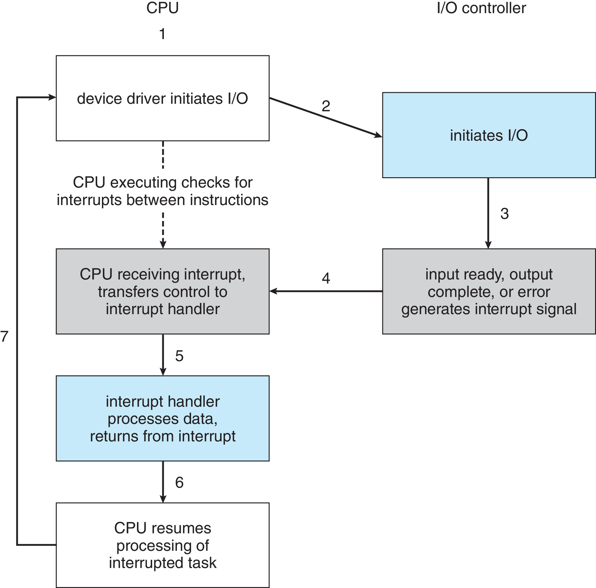
Interrupt-Driven I/O Cycle

Slide 73
Interrupts (Cont.)
Interrupt mechanism also used for exceptions
Terminate process, crash system due to hardware error
Page fault executes when memory access error
System call executes via trap to trigger kernel to execute request
Multi-CPU systems can process interrupts concurrently
If operating system designed to handle it
Used for time-sensitive processing, frequent, must be fast

Slide 74
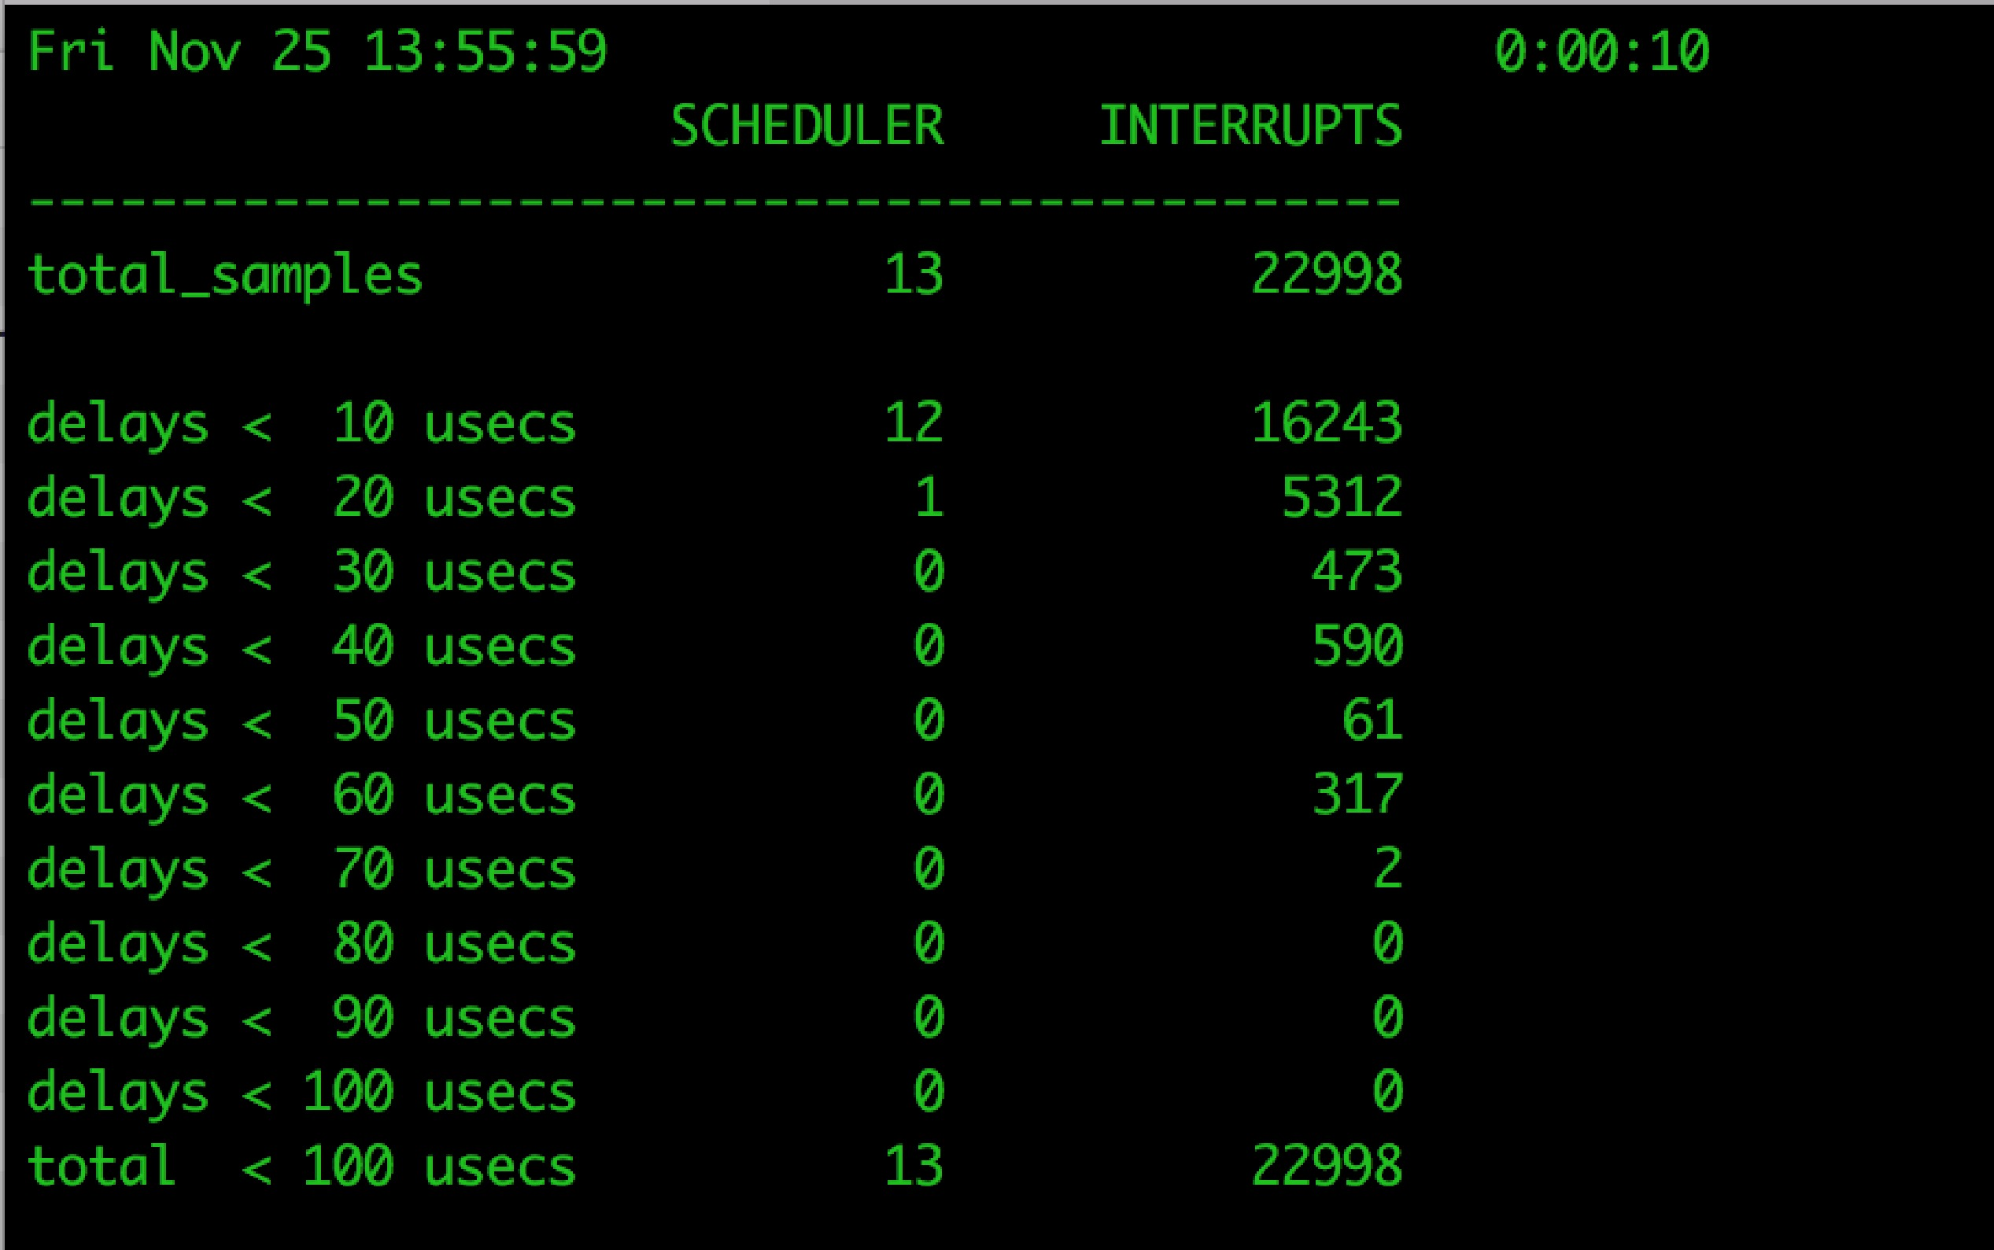
Latency
Stressing interrupt management because even single-user systems manage hundreds or interrupts per second and servers hundreds of thousands
For example, a quiet macOS desktop generated 23,000 interrupts over 10 seconds

Slide 75
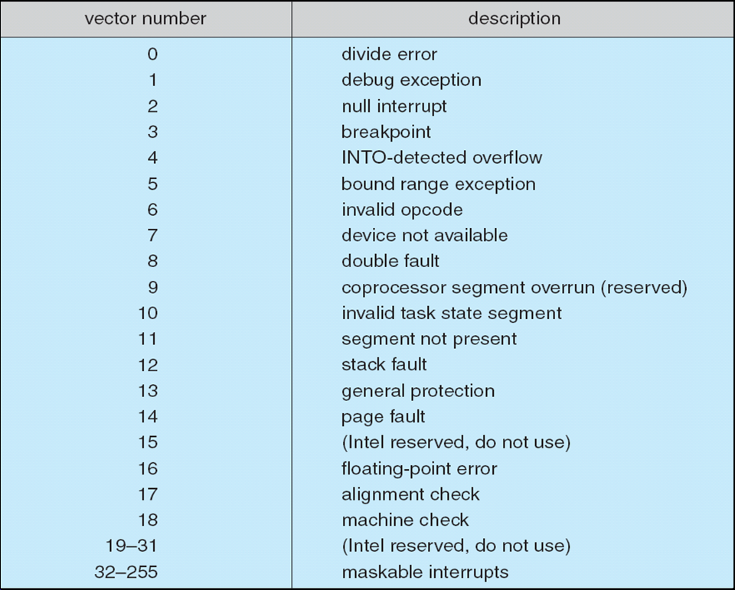
Intel Pentium Processor Event-Vector Table

Slide 76
Direct Memory Access
Used to avoid programmed I/O (one byte at a time) for large data movement
Requires DMA controller
Bypasses CPU to transfer data directly between I/O device and memory
OS writes DMA command block into memory
Source and destination addresses
Read or write mode
Count of bytes
Writes location of command block to DMA controller
Bus mastering of DMA controller – grabs bus from CPU
Cycle stealing from CPU but still much more efficient
When done, interrupts to signal completion
Version that is aware of virtual addresses can be even more efficient - DVMA

Slide 77
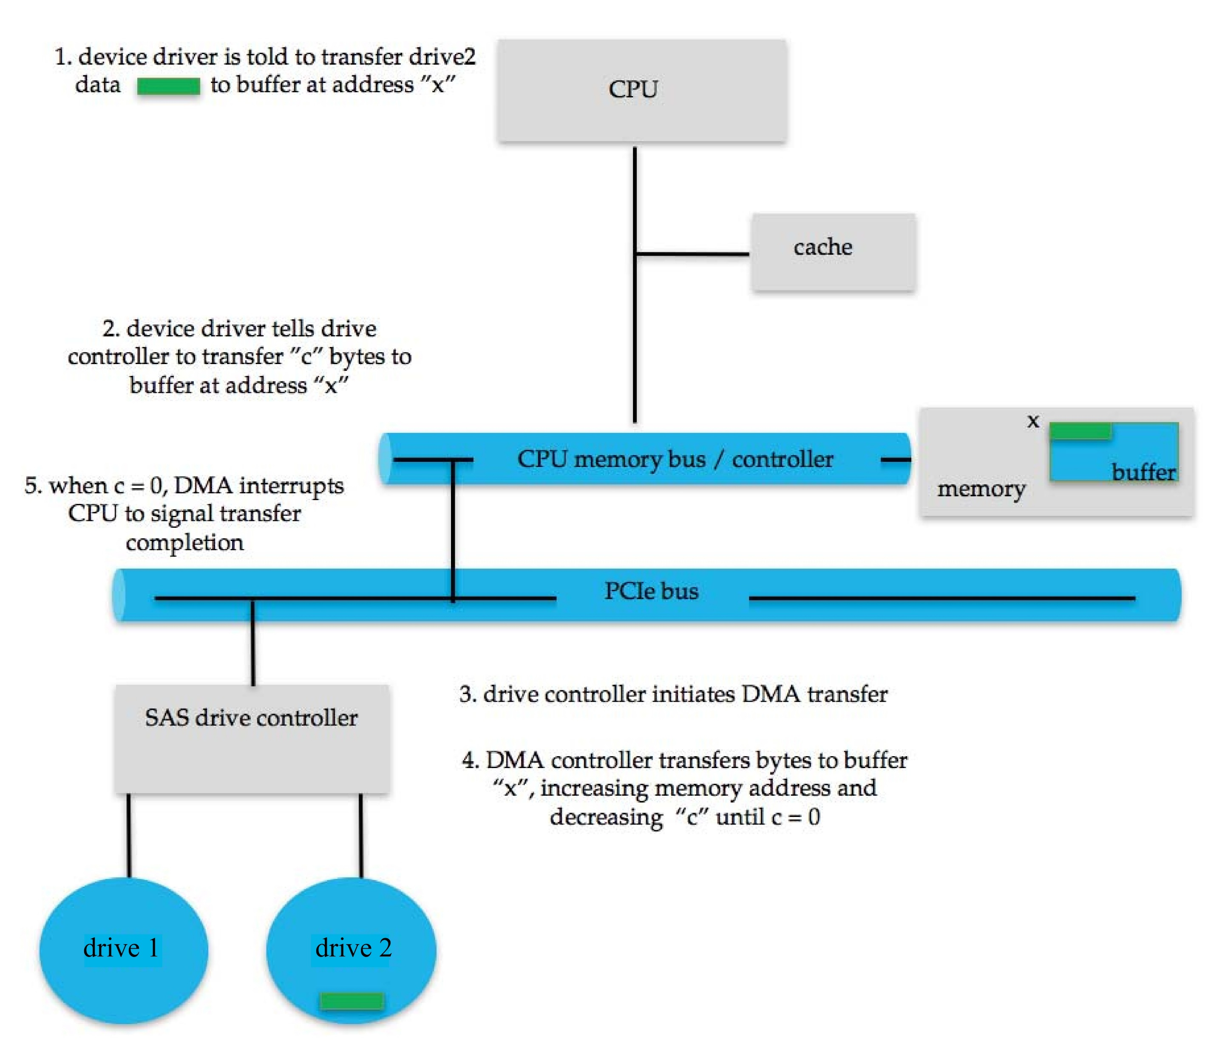
Six Step Process to Perform DMA Transfer

Slide 78
Application I/O Interface
I/O system calls encapsulate device behaviors in generic classes
Device-driver layer hides differences among I/O controllers from kernel
New devices talking already-implemented protocols need no extra work
Each OS has its own I/O subsystem structures and device driver frameworks
Devices vary in many dimensions
Character-stream or block
Sequential or random-access
Synchronous or asynchronous (or both)
Sharable or dedicated
Speed of operation
read-write, read only, or write only

